Slide 1
Secure UART Implementation on FPGA
Project Supervisor : Dr. Sunny Sharma
Indian Institute of Information Technology, Allahabad
Project B.Tech E.C.E 5th Semester
Group Members: IEC2014002 Ritwick Sundar
IEC2014090 Utkarsh Singh
IEC2014097 Kshitij Garg

Slide 2
Abstract
UART - Universal Asynchronous Transmitter Receiver is a computer hardware device for asynchronous communication in conjunction with communication standards like RS-232.
UART works on a serial-to-parallel and parallel-to-serial data transfer protocol.
Mostly used for short-distance, low-cost data exchange between computer and peripherals.
Secure UART - Data transfer is secured using Secure Hashing Algorithm-1 (SHA-1) mainly for high speed integrity checks with end-to-end control in industrial uses.
SHA-1 : It is a cryptographic hash function designed by the United States National Security Agency and is a U.S. Federal Information Processing Standard published by the United States NIST.
SHA-1 produces a 40 digit hex hash value known as a message digest.

Slide 3
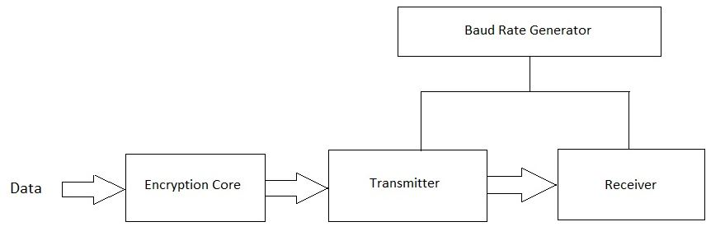
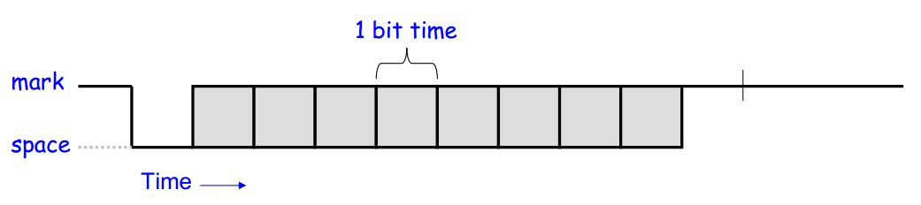
Block Diagram
Full UART
Transmitted Bitstream

Slide 4
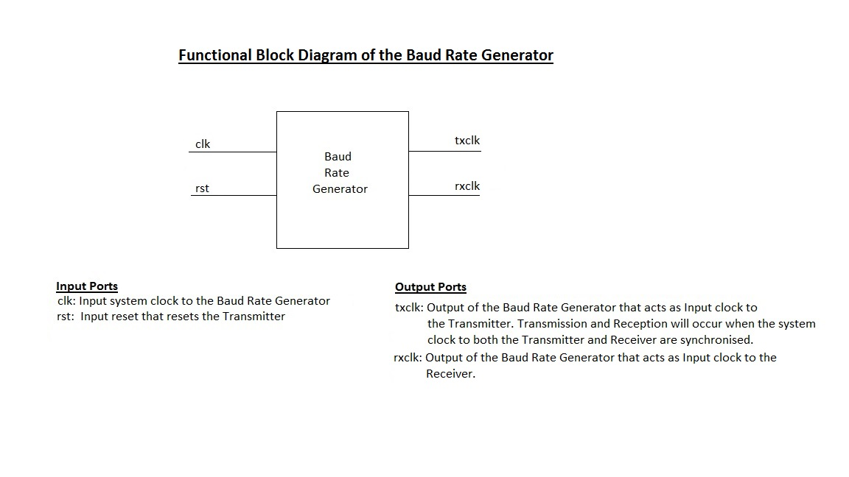

Slide 5
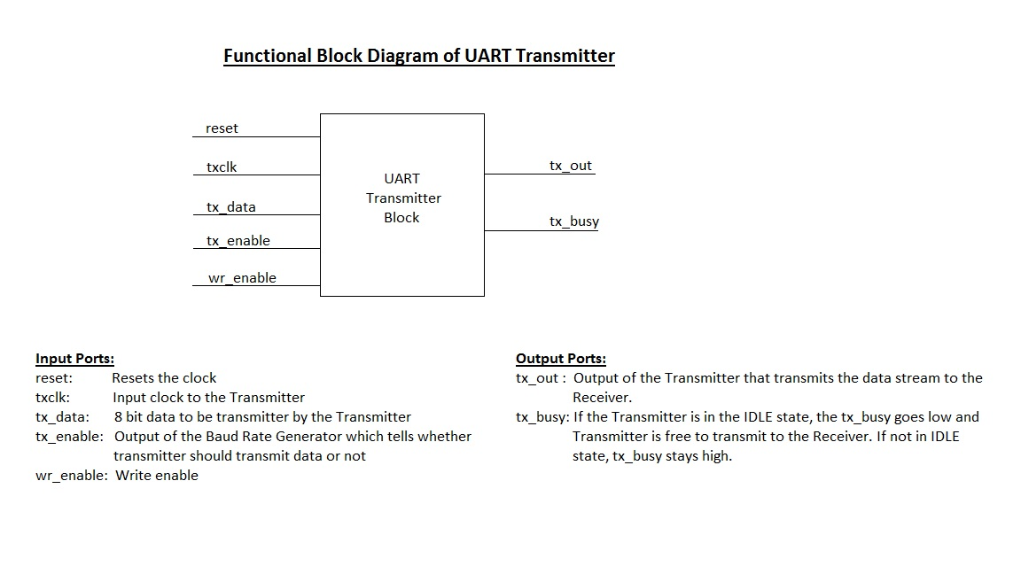

Slide 6
Introduction
UART (Universal Asynchronous Receiver Transmitter) is an integrated circuit, which is used for transmitting and receiving data asynchronously via the serial port on the computer. It contains a parallel-to-serial converter for data transmitted from the computer and a serial-to-parallel converter for data coming in via the serial line. The UART also has a buffer for temporarily storing data from high-speed transmissions.
UART will usually provide additional circuits for signals that can be used to indicate the state of the transmission media and to regulate the flow of data in the event that the remote device is not prepared to accept more data.
The typical UART consists of three basic modules :
Baud Rate Generator
Transmitter
Receiver

Slide 7
Secure UART
The transmitted data from a UART is not secured by the UART module itself but by the software of the electronic device the UART is connected to.
In this project we aim to integrate both the Encryption module and UART together for a full Hardware implementation and create a Secure UART.
The messages can be encoded in different protocols like AES ,Tiny Encryption, etc based on specific requirements.
For our project we aim to implement Secure Hashing Algorithm - 1 (SHA-1) with the UART module.
Hence our transmitted messages will be a 40 digit hex code in the final implementation.

Slide 8
Advantages of Hardware Implementation
The hardware based encryption uses a device’s on-board security to perform encryption and decryption.
It is self-contained and does not require the help of any additional software or driver.
Free from any possibility of contamination, malicious code infection, or vulnerability.
Minimum user interaction and does not cause performance degradation.
Hardware Implementation offers stronger resilience against brute force attacks.
Faster than any software implementation.
Reduces CPU overhead as the hardware itself is responsible for Encryption.

Slide 9
Progress So-Far
Learnt Basics of Verilog HDL
Completed Baud Rate Generator Module
Completed Transmitter Module
Simulated Transmitter to transmit an 8 bit code on Xilinx Vivado 2016.2
Timing Analysis of the modules
Deliverables till End-Sem
Full UART Module (Baud Rate Generator, Transmitter, Receiver)
SHA-1 Encryption Core
Integrating SHA-1 Core with UART
Full Timing and Performance Analysis
FPGA Implementation

Slide 10
Baud Rate Generator
The Baud Rate Generator contains 2 internal counters - one for Transmitter and one for Receiver clock.
The Counters are used as Frequency Dividers.
The Receiver clock frequency is normally 16 times the Transmitter clock frequency for oversampling.
The Baud Rate Generator implemented uses Divide by 16 to create the 16:1 receiver to transmitter clock speed ratio.
The Divide by 16 counter is a 4 bit counter. Once the counter reaches 15 , the transmitter clock goes high and counter is reset to 0.

Slide 11
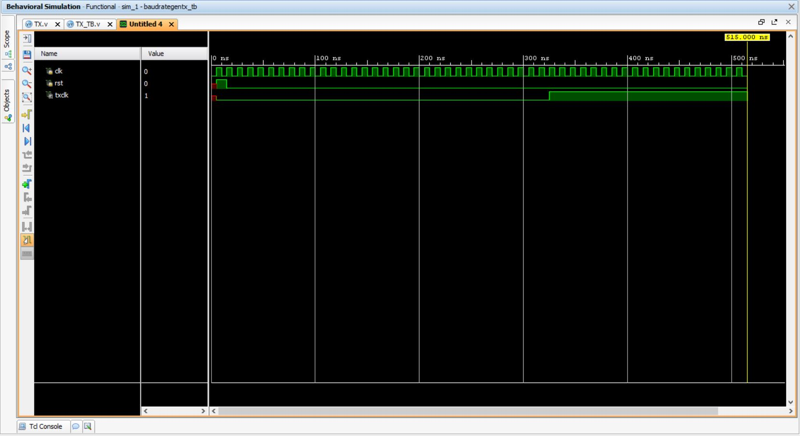
Timing Diagram
Timing Diagram of Transmitter clock ( System Clock / 16 ) as generated by Baud Rate Generator.

Slide 12
Transmitter The Transmitter takes in input from an 8 bit register and waits for wr_enable ( CPU signal ) to transmit. By convention the default output is kept high to signify that line is active but idle. Its function is to convert the parallel data to serial format and transmit it, An even parity module has been created to send along the data for integrity check. Inputs to the Transmitter include : Reset, Tx_Enable(Clock) ,Wr_enable, Tx_data and parity bit Ouputs from the Transmitter include : Tx_Out , Tx_Busy flag.

Slide 13
Transmitter
The Transmitter has been implemented as a Finite State Machine with 5 States :
1. IDLE - In Idle state the transmitter waits for the wr_enable (The CPU signal that tells UART it is sending data to be transmitted). 2. START- In Start state the transmitter makes the tx_out low to signal the start of data transmission to the receiver and sends out a 0 bit.
3. TX - The 8 bit data is now sent LSB first so that the data received by the receiver is in big-endian format (MSB-left LSB-right).
4. PARITY –The transmitter calculates the even parity of the transmitted code and appends it after the data transmission ; hence taking 1 bit for parity.
5. STOP - The ld_tx_data is made 0 and transmitter sends out 1 signalling completion of
data transfer. The transmitter returns to IDLE state after STOP and waits for
wr_enable.

Slide 14
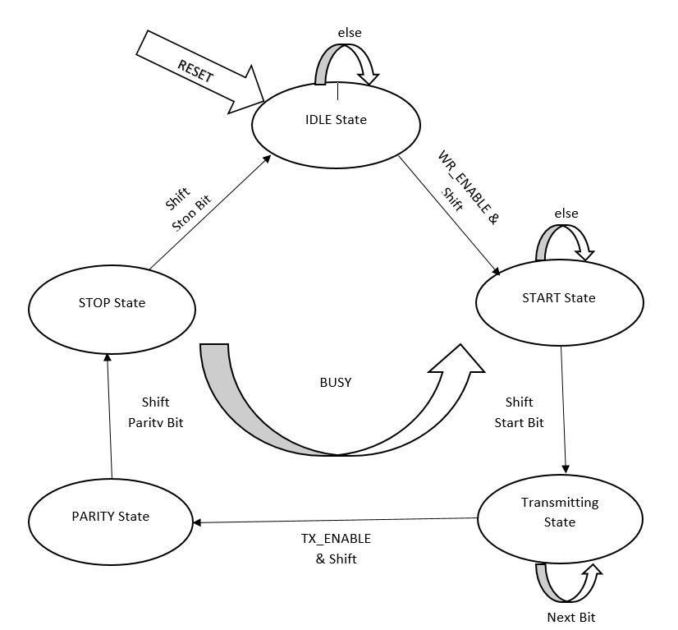
Transmitter FSM

Slide 15
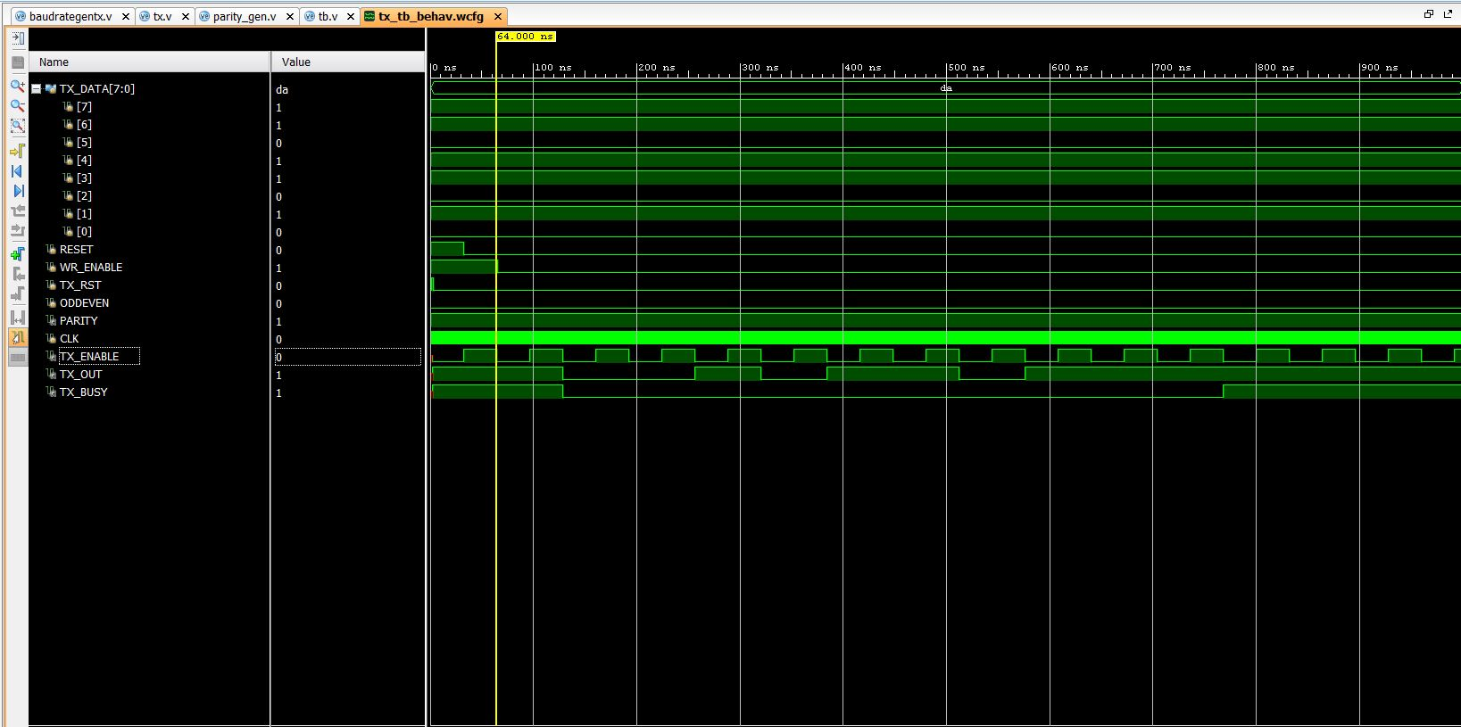
Overall Timing Diagram

Slide 16
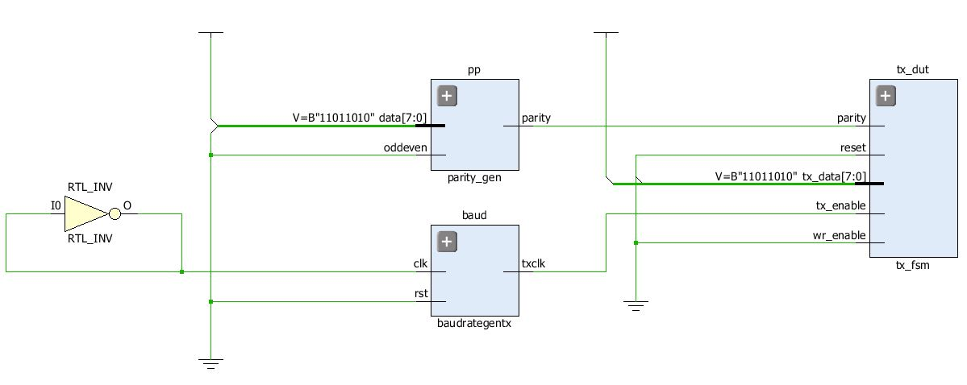
RTL Synthesis

Slide 17
Code : // Baud Rate Generator
#(parameter width = 4, N = 8) module baudrategentx(clk, rst, txclk); input clk, rst; output txclk; reg [width - 1:0] r_reg, txclk_track; wire [width - 1:0] r_nxt; always @ (negedge clk or negedge rst) begin if (rst) begin r_reg <= 0; txclk_track <= 1'b0; end else if (r_nxt == N) begin r_reg <= 0; txclk_track <= ~txclk_track; end else r_reg <= r_nxt; end assign r_nxt = r_reg + 1; assign txclk = txclk_track; endmodule

Slide 18
Code : // Parity Module
`timescale 1ns / 1ps module parity_gen ( data , oddeven , parity ); input [7:0] data; input oddeven; output parity; assign parity = (^data) ^ oddeven; endmodule

Slide 19
Code : // Transmitter
module tx_fsm ( reset , tx_data , wr_enable , tx_enable , parity , tx_out , tx_busy ); // Port declarations input reset ; input [7:0] tx_data ; input tx_enable ; input wr_enable ; input parity ; output tx_out ; output tx_busy ; // Internal Variables reg [7:0] tx_reg ; reg [3:0] tx_cnt ; reg tx_out ; reg tx_busy ; reg ld_tx_data ; reg [SIZE-1:0] state; parameter SIZE = 5; parameter IDLE = 3'b000, START = 3'b001, TX = 3'b010, PARITY = 3'b011, STOP = 3'b100;

Slide 20
always @ (negedge tx_enable) if (reset) begin tx_busy <= 1; tx_reg <= 0; tx_cnt <= 0; ld_tx_data <= 0; tx_out <= 1; state <= IDLE; end else case(state) IDLE : if (wr_enable) begin tx_reg <= tx_data; ld_tx_data <= 1; state <= START; tx_cnt <= 0; end START : if (!tx_enable) begin tx_busy <= 0; $display("TX of data has been started"); if(tx_cnt == 0) begin $display("Counter Value : %b",tx_cnt); tx_out <= 0; end state <= TX; tx_cnt <= tx_cnt + 1; end TX : if (!tx_enable) begin tx_out <= tx_reg[tx_cnt -1]; $display("Counter Value: %b",tx_cnt); tx_cnt <= tx_cnt +1 ; if(tx_cnt == 8) begin state <= PARITY; end end
PARITY: if(!tx_enable) begin tx_out <= parity; state <= STOP; $display("Parity Bit: %b",parity); end STOP : if(!tx_enable) begin ld_tx_data <=0; tx_out <= 1; tx_cnt <= 0; state <= #1 IDLE; tx_busy <= 1; $display("Counter Value: %b",tx_cnt); $display("TX of data has been completed"); end default : state <= #1 IDLE; endcase endmodule

Slide 21
References 1. Basu, Debjani, Dipak K. Kole, and Hafizur Rahaman. "implementation of AES algorithm in UART module for secured data transfer." In Advances in Computing and Communications (ICACC), 2012 International Conference on, pp. 142-145. IEEE, 2012. 2. Fang, Yi-yuan, and Xue-jun Chen. "Design and simulation of UART serial communication module based on VHDL." In Intelligent Systems and Applications (ISA), 2011 3rd International Workshop on, pp. 1-4. IEEE, 2011 3. Solanki, Yogendra Singh. "Performance Based Design and Implementation of a SHA-1 Hash Module on FPGA." 4. Verilog HDL : A Guide To Digital Design And Synthesis (IEEE 1364-2001 Compliant) – by Samir Palnitkar

